Slide 1

Car Overspeed Detection System
A project by Students of
Kendriya Vidyalaya NFC Vigyan Vihar, Delhi - 110095

Slide 2
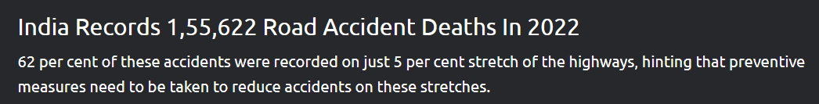
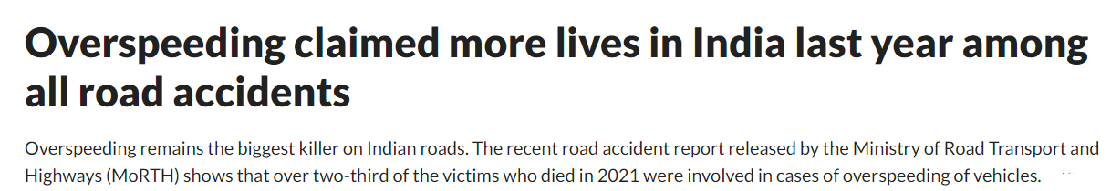
The “Why”

Slide 3
The “Solution”
A well designed system to properly detect weather which car is speeding and reporting to the closest police station

Slide 4
The “How”
Overspeed detection
(in the car)
Server
Database

Slide 5
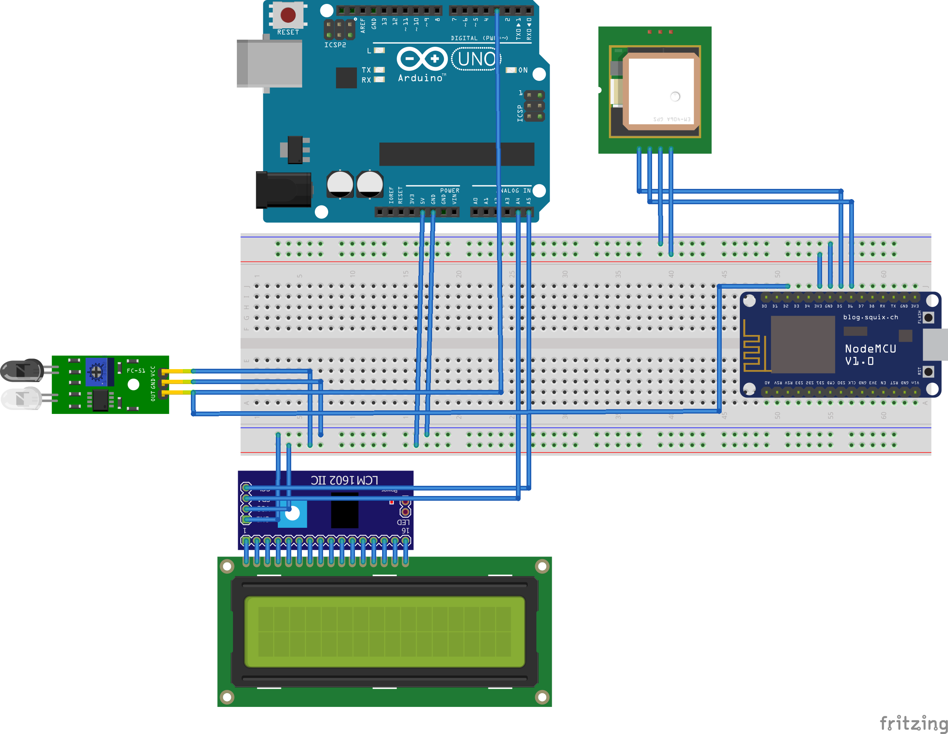
The “Working”

Slide 6
The “Stack”
Electronics
Essentials
Arduino UNO
ESP8266
NEO 6M GPS module
IR Sensor
Accessories
16x2 LCD
Server/Backend
Flask (python)
MongoDB
Vercel

Slide 7
The “Queries”
Q. Setup cost?
A. With some improvements, ~₹1000-1300
Q. No internet?
A. Error 404: Solution not found
Q. Security?
A. Custom

Slide 8
Thank you :)

